Slide 1
Classical Cryptography

Slide 2




Cryptography
Cryptography is the use of mathematical operations to protect messages traveling between parties or stored on a computer
Confidentiality means that someone intercepting your communications cannot read them
???
Copyright Pearson Prentice-Hall 2009

Slide 3
Encryption
Information has to be concealed from an unauthorised person (attacker), so that in the event that it is passively accessed (e.g., copied or intercepted) by an attacker, it should not be useful to them
There are actually two subjects that deal with the concealment of information from unauthorised people:
Cryptography is the study of hiding critical information by encoding it to a unintelligible form using a secret key
  The encoding is commonly called encryption
  If the information is compromised, the attacker should not be able to decode (decrypt) it back to the original information without knowledge of the secret key
Steganography is the study of hiding critical information within some other less important information:
  If the less important information is compromised, the attacker should not be able to even identify, let alone extract, the critical information

Slide 4
Authentication
Information has to be protected so that, in the event that it is modified or replaced by an unauthorised person (attacker), the people with legitimate access should be able to tell that the information is not authentic (i.e., in the original form)
There are various mechanisms that implement authentication, including:
  Message Authentication Codes (MACs)
  Digital Signatures

Slide 5
Types of threats
Passive attack (confidentiality):
Active attack (confidentiality & integrity):
Sender
message
Receiver
Attacker
Sender
Attacker
Receiver
message
message
(modified)

Slide 6
Cryptography
Cryptography means “hidden writing” (in Greek).
It is the study of encoding meaningful information (also called the message or the plaintext) using a secret transformation function (called the cipher) so that nobody will understand the encoded message (called the ciphertext) unless they have knowledge of the cipher.
The process of encoding plaintext to ciphertext is called encryption.
The process of decoding ciphertext back to the original message (plaintext) is called decryption.

Slide 7
Conventional cryptography
shared secret (key)
Sender
Receiver
plaintext
plaintext
Encryption
ciphertext
Decryption
Attacker

Slide 8
Mathematical representation
In mathematical terms, encryption and decryption can be described as follows:
  Encryption: c = F(p)
  Decryption: p= F^{–1}(c)
Where the plaintext is represented by p, the ciphertext is c and the cipher is the bijective function F.
Basically, this means that all possible ciphertexts have unique corresponding plaintexts (mathematical conditions of a bijective function are that it is one-to-one and onto)
Both p and c are members of the set of all possible messages M and so F is a mapping F : M  M

Slide 9
ROT-13 cipher
The ROT-13 cipher was commonly used to hide the meaning of messages on the Internet (particularly on Usenet and E-mail).
Each letter in the plaintext is substituted with the ciphertext letter according to the following mapping:
p : ABCDEFGHIJKLMNOPQRSTUVWXYZ
F(p) : NOPQRSTUVWXYZABCDEFGHIJKLM
Example:
  Plaintext: THIS IS A SECRET
  Ciphertext: GUVF VF N FRPERG
The ROT-13 cipher is an involution (i.e., self-inverse) so that encoding twice will result in the original message.
This means that a separate decoding function F^{–1} is not needed.

Slide 10
Caesar cipher
The Roman emperor Julius Caesar used to substitute each letter in his diplomatic communications with the letter that was three letters further along in the alphabet.
p : ABCDEFGHIJKLMNOPQRSTUVWXYZ
F(p) : DEFGHIJKLMNOPQRSTUVWXYZABC
Plaintext: ET TU BRUTUS
Ciphertext: HW WX EUXWXV

Slide 11
Caesar cipher
The cipher used by Julius Caesar can be generalized to a function defined by a parameter k representing the number of letters that we “shift” each plaintext letter:
c = F_{k}(p) = p + k (mod 26)
Where Julius Caesar used k=3, and ROT-13 uses k=13.
This cipher is called the Caesar cipher.
The parameter k is called the key.
Example: YVCCF Z YFGV PFL WZEU KYZJ ZEKVIVJKZEX

Slide 12
Simple substitution cipher
A generalization of the Caesar cipher, called a simple substitution cipher or monoalphabetic substitution cipher, maps plaintext letters to ciphertext letters according to a fixed mapping (the key).
Example:
  p : ABCDEFGHIJKLMNOPQRSTUVWXYZ
  F_{k}(p) : QWERTYUIOPASDFGHJKLZXCVBNM
Both the sender and receiver secretly share the key, representing the plaintext-ciphertext letter mapping, which is also called the substitution alphabet.

Slide 13
Railfence cipher
A transposition cipher rearranges the plaintext letters according to a secret transformation defined by the key.
The simplest example of this is the railfence cipher, in which the plaintext is written in rows of n-letter blocks (the number of columns n is the key) and then the ciphertext is read in columns
Example:
  Plaintext: TRANSPOSITIONCIPHERX
  In this example, the key is: 5
  Re-write as rows of 5-letter blocks:
    TRANS
    POSIT
    IONCI
    PHERX
  Ciphertext: TPIPROOHASNENICRSTIX

Slide 14
Transposition cipher
Problems with the railfence cipher:
  The first and last letters of the plaintext do not move
  The key is a number that divides the total message length
In a single columnar transposition cipher, the key is a word or phrase whose letters, in alphabetic order, indicate the order of the columns as they are read
Example:
  Plaintext: TRANSPOSITIONCIPHER
  Key is “SECRET”, so re-write as rows of 6-letter blocks:
    SECRET CEERST
    521436 123456
    TRANSP ARSNTP
    OSITIO ISITOO
    NCIPHE ICHPNE
    R R
  Ciphertext: AIIRSCSIHNTPTONRPOE

Slide 15
Cryptanalysis
Cryptanalysis is the study of breaking ciphers (also called codebreaking or cracking) or reading encrypted messages without knowledge of the key
Goals:
  Decrypt a message
  Recover the key
Types of attacks depend on:
  The type of information available
  Interaction with the cipher

Slide 16
Types of cryptanalytic attacks
A ciphertext only attack is when an attacker has a quantity of ciphertext
  Goal is to recover the plaintext or the key
A known plaintext attack is when an attacker has a quantity of ciphertext and its corresponding plaintext
  Goal is to recover the key
A chosen plaintext attack is when an attacker can obtain a quantity of ciphertext corresponding to plaintext supplied by the attacker
  Goal is to recover the key

Slide 17
Cracking the Caesar cipher
Caesar cipher is defined by:
c = F_{k}(p) = p + k (mod 26)
There are only 26 possible values of k (the key)
Out of these 26, only 25 values of k are valid keys (since k=0 has no effect on the plaintext)
We can break a Caesar cipher by trying all 25 possible valid keys
This is called an exhaustive key search.

Slide 18
Example: Exhaustive key search
Suppose we have the ciphertext:
TYQZCXLETZYDPNFCTEJ
We decrypt the ciphertext by trying all 25 possible valid keys:
UZRADYMFUAZEQOGDUFK
VASBEZNGVBAFRPHEVGL
WBTCFAOHWCBGSQIFWHM
XCUDGBPIXDCHTRJGXIN
YDVEHCQJYEDIUSKHYJO
ZEWFIDRKZFEJVTLIZKP
AFXGJESLAGFKWUMJALQ
BGYHKFTMBHGLXVNKBMR
CHZILGUNCIHMYWOLCNS
DIAJMHVODJINZXPMDOT
EJBKNIWPEKJOAYQNEPU
FKCLOJXQFLKPBZROFQV
GLDMPKYRGMLQCASPGRW
HMENQLZSHNMRDBTQHSX
INFORMATIONSECURITY
JOGPSNBUJPOTFDVSJUZ
KPHQTOCVKQPUGEWTKVA
LQIRUPDWLRQVHFXULWB
MRJSVQEXMSRWIGYVMXC
NSKTWRFYNTSXJHZWNYD
OTLUXSGZOUTYKIAXOZE
PUMVYTHAPVUZLJBYPAF
QVNWZUIBQWVAMKCZQBG
RWOXAVJCRXWBNLDARCH
SXPYBWKDSYXCOMEBSDI

Slide 19
Cracking the simple substitution cipher
There are 26! = ~4 x 10²⁶ possible keys
Exhaustive key search is not practical
Simple substitution ciphers were considered strong for many centuries
In 850 CE, Arab/Iraqi scientist Abu Yusuf Yaqub ibn Ishaq al-Kindi published his book “Risalah fi Istikhraj al-Mu’amma” (A Manuscript on Deciphering Cryptographic Messages), which contains the first ever published description of how to crack simple substitution ciphers
The method he described is now known as frequency analysis

Slide 20
Frequency analysis
The statistical distribution of letter frequencies of a message (text) written in any language tend towards a known letter frequency distribution profile of the language
This is particularly true for long messages (i.e., the longer the text, the closer the letter frequency distributions match the language’s letter frequency distributions)
The simple substitution cipher preserves the letter frequency distributions of the plaintext in the ciphertext (i.e., information about the plaintext is leaked in the ciphertext)
The attacker takes a frequency count of the ciphertext letters and tries to match them to the letter frequency distribution profile of the plaintext language

Slide 21
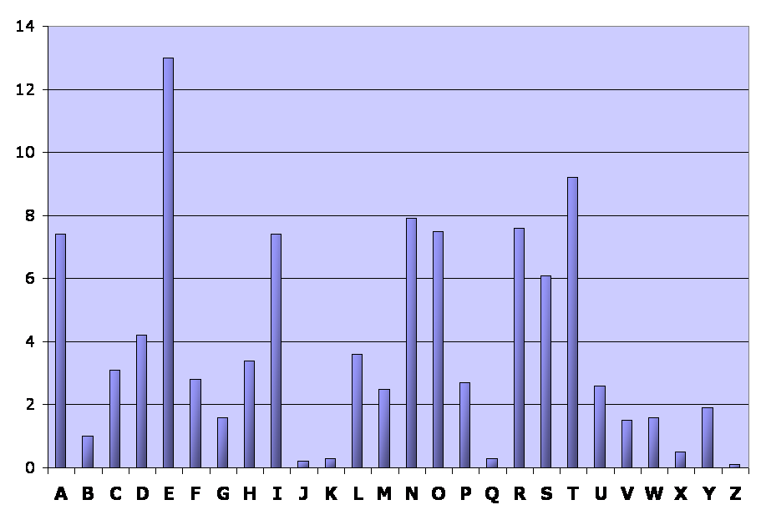
English language:
Relative letter frequencies
Letter | A | B | C | D | E | F | G | H | I | J | K | L | M
Frequency | 7.4 | 1.0 | 3.1 | 4.2 | 13.0 | 2.8 | 1.6 | 3.4 | 7.4 | 0.2 | 0.3 | 3.6 | 2.5
Letter | N | O | P | Q | R | S | T | U | V | W | X | Y | Z
Frequency | 7.9 | 8.0 | 2.7 | 0.3 | 8.0 | 6.1 | 9.2 | 2.6 | 1.5 | 1.6 | 0.5 | 1.9 | 0.1

Slide 22
Example: Frequency analysis
Ciphertext:
R jrk hbxiu lk vai vzihova ohlls lo rk rmrsvjikv ywbhtbkn. Ixise jlskbkn ai vrgiu vai ihixrvls tlzk vl vai hlyye rkt hirxiu vai ywbhtbkn. Bk vai ixikbkn, ai nivu bkvl vai ihixrvls, rkt, bo vaisi bu uljilki ihui bk vai ihixrvls -- ls bo bv zru srbkbkn varv tre -- ai nliu yrpg vl abu ohlls tbsipvhe. Alzixis, bo vaisi bu klylte ihui bk vai ihixrvls rkt bv aruk'v srbkit, ai nliu vl vai vikva ohlls rkt zrhgu wm vzl ohbnavu lo uvrbsu vl abu sllj.
Letter frequency count (total = 344 letters):
Letter | A | B | C | D | E | F | G | H | I | J | K | L | M
Frequency | 23 | 26 | 0 | 0 | 5 | 0 | 3 | 18 | 49 | 5 | 26 | 32 | 2
Letter | N | O | P | Q | R | S | T | U | V | W | X | Y | Z
Frequency | 9 | 10 | 2 | 0 | 24 | 19 | 11 | 19 | 37 | 3 | 9 | 6 | 6

Slide 23
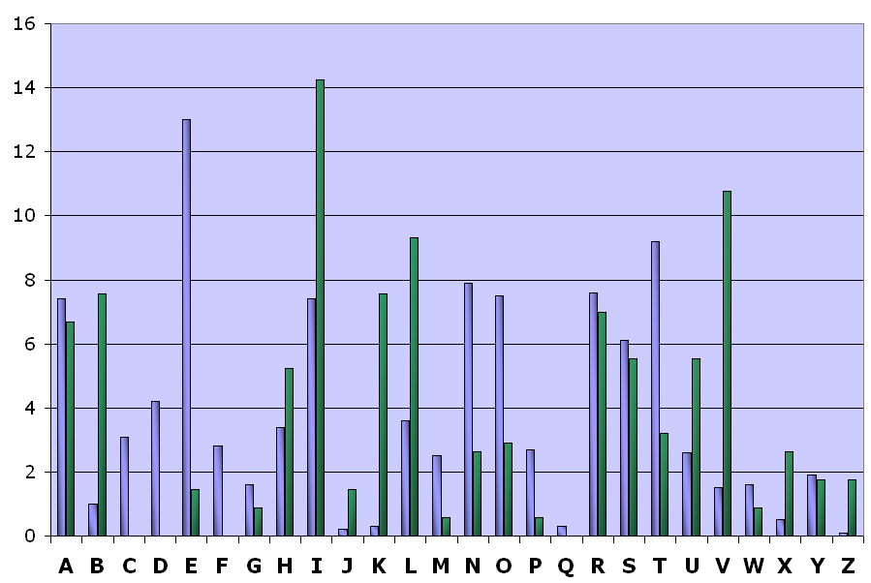
Relative frequency distributions
(English & ciphertext)

Slide 24
Example: Frequency analysis
From the frequency distributions, we assume that:
  The ciphertext letter I corresponds to the plaintext letter E (the most frequent letter in the English language)
  The ciphertext letter V corresponds to the plaintext letter T (the second most frequent letter in the English language)
Partially decrypted ciphertext (green = plaintext):
R jrk hbxeu lk vae vzehova ohlls lo rk rmrsvjekv ywbhtbkn. Exese jlskbkn ae vrgeu vae ehexrvls tlzk vl vae hlyye rkt herxeu vae ywbhtbkn. Bk vae exekbkn, ae nevu bkvl vae ehexrvls, rkt, bo vaese bu uljelke ehue bk vae ehexrvls -- ls bo bv zru srbkbkn varv tre -- ae nleu yrpg vl abu ohlls tbsepvhe. Alzexes, bo vaese bu klylte ehue bk vae ehexrvls rkt bv aruk'v srbket, ae nleu vl vae vekva ohlls rkt zrhgu wm vzl ohbnavu lo uvrbsu vl abu sllj.

Slide 25
Example: Frequency analysis
From the frequency distributions, we assume that:
  The ciphertext letter I corresponds to the plaintext letter E (the most frequent letter in the English language)
  The ciphertext letter V corresponds to the plaintext letter T (the second most frequent letter in the English language)
Partially decrypted ciphertext (green = plaintext):
R jrk hbxeu lk tae tzehota ohlls lo rk rmrsvjekt ywbhtbkn. Exese jlskbkn ae trgeu tae ehexrtls tlzk tl tae hlyye rkt herxeu tae ywbhtbkn. Bk tae exekbkn, ae nevu bktl tae ehexrtls, rkt, bo taese bu uljelke ehue bk tae ehexrtls -- ls bo bt zru srbkbkn tart tre -- ae nleu yrpg tl abu ohlls tbsepthe. Alzexes, bo taese bu klylte ehue bk tae ehexrvls rkt bt aruk't srbket, ae nleu tl tae tekta ohlls rkt zrhgu wm tzl ohbnatu lo utrbsu tl abu sllj.

Slide 26
Example: Frequency analysis
We can assume that the ciphertext letter A corresponds to the plaintext letter H because:
  The digram ‘TH’ is the most common in the English language
  The word “THE” is the only frequently used 3-letter English word starting with T and ending with E
Partially decrypted ciphertext (green = plaintext):
R jrk hbxeu lk the tzehoth ohlls lo rk rmrsvjekt ywbhtbkn. Exese jlskbkn he trgeu the ehexrtls tlzk tl the hlyye rkt herxeu the ywbhtbkn. Bk the exekbkn, he nevu bktl the ehexrtls, rkt, bo these bu uljelke ehue bk the ehexrtls -- ls bo bt zru srbkbkn thrt tre -- he nleu yrpg tl hbu ohlls tbsepthe. Hlzexes, bo taese bu klylte ehue bk the ehexrtls rkt bt hruk't srbket, he nleu tl the tekth ohlls rkt zrhgu wm tzl ohbnatu lo utrbsu tl hbu sllj.

Slide 27
Example: Frequency analysis
We can assume that the ciphertext letter R corresponds to the plaintext letter A because:
  The word “THAT” is the only frequently used 4-letter English word starting with ‘TH’ and ending with T
  The relative frequency of R in the ciphertext closely approximates the relative frequency of A in English
Partially decrypted ciphertext (green = plaintext):
A jak hbxeu lk the tzehoth ohlls lo ak amasvjekt ywbhtbkn. Exese jlskbkn he tageu the ehexatls tlzk tl the hlyye akt heaxeu the ywbhtbkn. Bk the exekbkn, he nevu bktl the ehexatls, akt, bo these bu uljelke ehue bk the ehexatls -- ls bo bt zau sabkbkn that tae -- he nleu yapg tl hbu ohlls tbsepthe. Hlzexes, bo taese bu klylte ehue bk the ehexatls akt bt hauk't sabket, he nleu tl the tekth ohlls akt zahgu wm tzl ohbnatu lo utabsu tl hbu sllj.

Slide 28
Example: Frequency analysis
We can assume that the ciphertext letter K corresponds to the plaintext letter N because:
  The words “AN” and “AT” are the only frequently used 2-letter English words starting with A
  The relative frequency of K in the ciphertext closely approximates the relative frequency of N in English
Partially decrypted ciphertext (green = plaintext):
A jan hbxeu ln the tzehoth ohlls lo an amasvjent ywbhtbnn. Exese jlsnbnn he tageu the ehexatls tlzn tl the hlyye ant heaxeu the ywbhtbnn. Bn the exenbnn, he nevu bntl the ehexatls, ant, bo these bu uljelne ehue bn the ehexatls -- ls bo bt zau sabnbnn that tae -- he nleu yapg tl hbu ohlls tbsepthe. Hlzexes, bo taese bu nlylte ehue bn the ehexatls ant bt haun't sabnet, he nleu tl the tekth ohlls ant zahgu wm tzl ohbnatu lo utabsu tl hbu sllj.

Slide 29
Example: Frequency analysis
We assume that:
  The ciphertext letter T corresponds to the plaintext letter D (from the word ‘ant’)
  The ciphertext letter B corresponds to the plaintext letter I (from the words ‘bt’ and ‘bn’)
Partially decrypted ciphertext (green = plaintext):
A jan hixeu ln the tzehoth ohlls lo an amasijent ywihtinn. Exese jlsninn he tageu the ehexatls dlzn tl the hlyye and heaxeu the ywihdinn. In the exeninn, he nevu intl the ehexatls, and, io these iu uljelne ehue in the ehexatls -- ls io it zau saininn that dae -- he nleu yapg tl hbu ohlls tisepthe. Hlzexes, io taese iu nlylte ehue in the ehexatls ant it haun't sainet, he nleu tl the tekth ohlls and zahgu wm tzl ohinatu lo utaisu tl hiu sllj.

Slide 30
Example: Frequency analysis
If you continue like this, completing words (using your knowledge of the English language) and matching ciphertext letters with probable plaintext letters (using the relative frequencies), you will eventually obtain a complete decryption of the message and will also have recovered the key (the substitution alphabet)
The substitution alphabet for this example is:
  p : ABCDEFGHIJKLMNOPQRSTUVWXYZ
  F_{k}(p) : RYPTIONABFGHJKLMQSUVWXZDEC

Slide 31
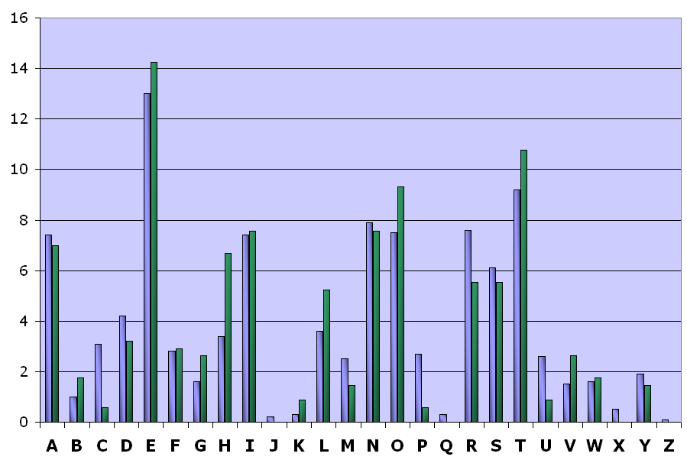
Relative frequency distributions
(English & plaintext)

Slide 32
Other English language features
Digram frequencies
  Common digraphs: EN, RE, ER, NT, TH
Trigram frequencies
  Common trigrams: THE, ING, THA, ENT
Vowels other than E are rarely followed by another vowel
The letter Q is followed only by U

Slide 33
Polyalphabetic ciphers
The simple substitution cipher is weak because the attacker can exploit the fact that:
  The letter frequency distribution of the ciphertext will match the letter frequency distribution of the plaintext
  These will generally follow the letter frequency distribution of the plaintext language
A simple way to defeat frequency analysis is to encipher each plaintext letter with a different substitution alphabet
The use of multiple substitution alphabets will mean that a plaintext letter can encrypt to different ciphertext letters, thus causing the letter frequency distribution to appear “flatter” (the individual letter frequencies are averaged out)
A cipher that uses multiple substitution alphabets is called a polyalphabetic substitution cipher

Slide 34
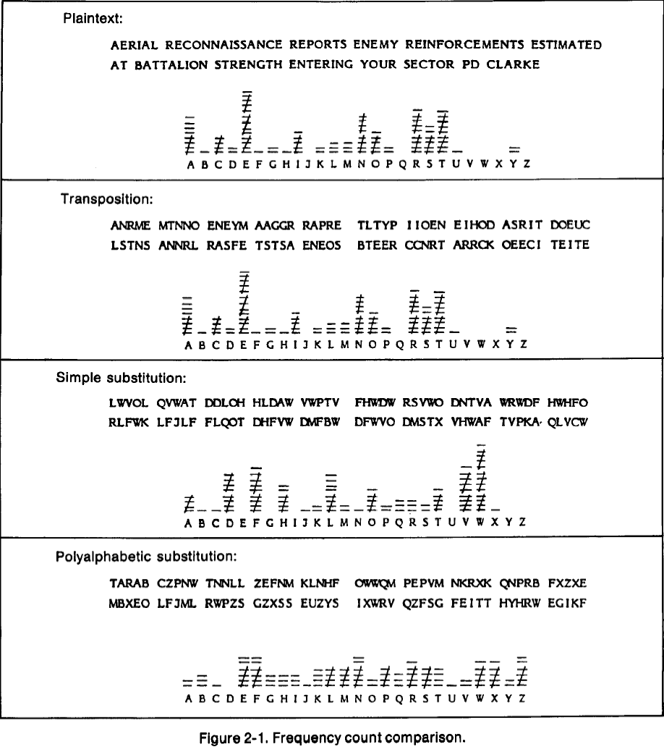
Letter frequency distributions

Slide 35
Vigènere cipher
The Vigènere cipher is a polyalphabetic substitution cipher
A secret word or phrase, representing the key, is agreed by the sender and receiver
Each letter of the key is used to encrypt a plaintext letter using the Caesar cipher; each key letter represents the “shift” amount (i.e., A=0, B=1, …, Z=25).
After the final key letter is used to encrypt a plaintext letter, the first key letter is used (again) to encrypt the next plaintext letter, and the cipher continues like this; this type of cipher is called repeated key.

Slide 36
Vigènere tableau
A B C D E F G H I J K L M N O P Q R S T U V W X Y Z
B C D E F G H I J K L M N O P Q R S T U V W X Y Z A
C D E F G H I J K L M N O P Q R S T U V W X Y Z A B
D E F G H I J K L M N O P Q R S T U V W X Y Z A B C
E F G H I J K L M N O P Q R S T U V W X Y Z A B C D
F G H I J K L M N O P Q R S T U V W X Y Z A B C D E
G H I J K L M N O P Q R S T U V W X Y Z A B C D E F
H I J K L M N O P Q R S T U V W X Y Z A B C D E F G
I J K L M N O P Q R S T U V W X Y Z A B C D E F G H
J K L M N O P Q R S T U V W X Y Z A B C D E F G H I
K L M N O P Q R S T U V W X Y Z A B C D E F G H I J
L M N O P Q R S T U V W X Y Z A B C D E F G H I J K
M N O P Q R S T U V W X Y Z A B C D E F G H I J K L
N O P Q R S T U V W X Y Z A B C D E F G H I J K L M
O P Q R S T U V W X Y Z A B C D E F G H I J K L M N
P Q R S T U V W X Y Z A B C D E F G H I J K L M N O
Q R S T U V W X Y Z A B C D E F G H I J K L M N O P
R S T U V W X Y Z A B C D E F G H I J K L M N O P Q
S T U V W X Y Z A B C D E F G H I J K L M N O P Q R
T U V W X Y Z A B C D E F G H I J K L M N O P Q R S
U V W X Y Z A B C D E F G H I J K L M N O P Q R S T
V W X Y Z A B C D E F G H I J K L M N O P Q R S T U
W X Y Z A B C D E F G H I J K L M N O P Q R S T U V
X Y Z A B C D E F G H I J K L M N O P Q R S T U V W
Y Z A B C D E F G H I J K L M N O P Q R S T U V W X
Z A B C D E F G H I J K L M N O P Q R S T U V W X Y
If n is the length of the key, then:
C_{i} = P_{i} + K _{(i + n) mod n}
Example:
Plaintext letter: T
Key letter: N
T = 19, N = 13
C = 19 + 13
= 32
= 6 (mod 26)
Ciphertext letter: G

Slide 37
Example: Vigènere cipher
Plaintext: THEBOYHASTHETHEORYHE…
Key: NUSTNUSTNUSTNUSTNUST…
Ciphertext: GBWUBSZTFNZXGBWHESZX…

Slide 38
The period of a cipher
Assuming the key is n letters long:
  The 1st, (n+1)-th, (2n+1)-th, etc., plaintext letters are encrypted using the same substitution alphabet
  The 2nd, (n+2)-th, (2n+2)-th, etc., plaintext letters are encrypted using the same substitution alphabet
  In general, the i-th, (n+i)-th, (2n+i)-th, etc., plaintext letters are encrypted using the same substitution alphabet
We say that the period of the cipher is n

Slide 39
Cracking the Vigènere cipher
Find the key length (period)
Write the ciphertext in n columns (where n is the period)
  Each column represents plaintext letters that were encrypted using the same substitution alphabet
Apply frequency analysis on each column of ciphertext letters to determine the substitution alphabet applied to the plaintext letters in that column
  Each substitution alphabet (“shifted” alphabet) represents a key letter, so we eventually recover the entire key word/phrase

Slide 40
Kasiski analysis
Kasiski analysis is a method to find the period of a repeated-key cipher:
  Look for all repetitions in the ciphertext (especially long repeated sequences); note the distance between pairs of repetitions
  The period of the cipher is probably a factor of the most frequently-noted distances between repetitions
Example:
  Ciphertext: GBWUBSZTFNZXGBWHESZX
  Repetitions: GBWUBSZTFNZXGBWHESZX 13–1=12
  GBWUBSZTFNZXGBWHESZX 18–6=12
  GBWUBSZTFNZXGBWHESZX 19–11=8
  Period is very likely to be one of: 2, 4

Slide 41
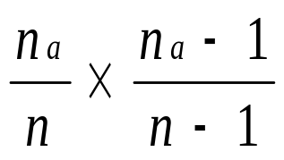
Letter coincidence
Coincidence: Picking two letters at random from a message that are identical
Probability of picking two A’s
  Let there be n letters in the ciphertext.
  Let there be n_{a} A’s in the ciphertext.
  The probability of selecting two A’s at random is

Slide 42
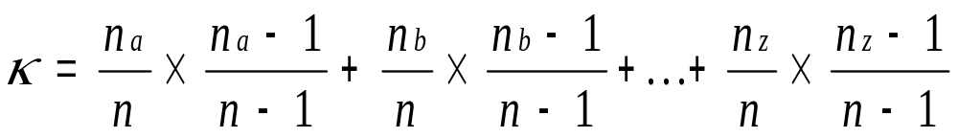
Index of Coincidence
Probability of choosing two identical letters is
Coincidence probabilities for two letters:
  English plaintext: ~0.0667
  Random English letters: 1/26 = ~0.0385

Slide 43
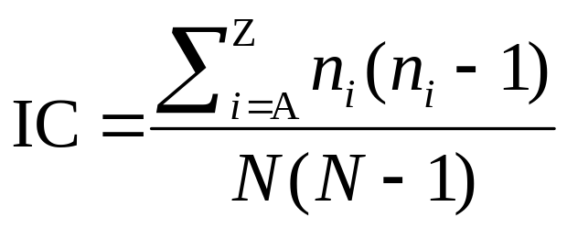
Index of Coincidence
The Index of Coincidence (IC) is a calculation that measures the roughness of the letter distribution probabilities in a text
It has a number of properties that are useful to cryptanalysis:
  It can help identify the language of plaintext
  It can help decide whether two ciphertexts were encrypted using the same key
  It can help determine the keylength of a repeated-key cipher
n_{i} is the number of times the letter i (A-Z) appears in the text
N is the total number of letters in the text

Slide 44
Example: Index of Coincidence
Ciphertext (simple substitution):
R jrk hbxiu lk vai vzihova ohlls lo rk rmrsvjikv ywbhtbkn. Ixise jlskbkn ai vrgiu vai ihixrvls tlzk vl vai hlyye rkt hirxiu vai ywbhtbkn. Bk vai ixikbkn, ai nivu bkvl vai ihixrvls, rkt, bo vaisi bu uljilki ihui bk vai ihixrvls -- ls bo bv zru srbkbkn varv tre -- ai nliu yrpg vl abu ohlls tbsipvhe. Alzixis, bo vaisi bu klylte ihui bk vai ihixrvls rkt bv aruk'v srbkit, ai nliu vl vai vikva ohlls rkt zrhgu wm vzl ohbnavu lo uvrbsu vl abu sllj.
Index of Coincidence = 0.071903

Slide 45
Example: Index of Coincidence
Ciphertext (Vigènere, polyalphabetic substitution):
N gsg ycnxf if muy lprfxmu zdhbl gy nh sinllfrhl uhcdwvhy. Xiyjr zijgvhy ar nsdrm lar ydxiulhe xgpa ng muy dhovq tax dxnpwl gbw uhcdwvhy. Ba nzx rpwgvhy, ar awmf cfmb nzx rfwonngk, nhv, bs nzxey al fiexbhw xymw ba nzx rfwonngk -- bl ay vn otf lsbacfz gbsm quq -- ar agxf vsvx ng avm xebij wvlwvgfq. Abqworl, ay gbwkr ck gbvgwl ydlr cf muy werpsmbl sgq cl anmf'm euagrx, zx tiwl gi lar nwggb xebij tax otyek nc noh sfazunk hs mltvlk mb bal eigf
Index of Coincidence = 0.043562

Slide 46
Example: Index of Coincidence
Table of key lengths (number of alphabets) and corresponding average ICs:
Key Length Average of ICs for each alphabet
1 0.043562
2 0.051680
3 0.044336
4 0.070315
5 0.045298
6 0.051872
7 0.042896
8 0.070460
9 0.047614
10 0.055396
11 0.042681
12 0.069011
IC is maximum at key lengths of 4, 8, 12
We assume that the key length is 4

Slide 47
Countering frequency analysis
If Vigènere key is very long, frequency analysis will not work
Problem: Long keys are hard to remember
Solution: Use multiple encryption
  Encrypting with a key m and key n is same as encryption by key whose length is the least common multiple of m and n
  If m and n are relatively prime (i.e., their greatest common divisor is 1) then the least common multiple is mn
Notes:
m=4, n=6 => mn=4*6=24
L.C.M of 4,6 = 12
M=5, n=6 => mn =5*6=30
LCM of 5,6 = 30

Slide 48
Advanced classical ciphers
Advanced classical ciphers:
  Operate on multiple characters of plaintext to produce multiple characters of ciphertext (i.e., operate on blocks); these are called polygraphic ciphers
  May apply a combination of substitution and transposition (one operation followed by another); these are called product ciphers
Examples:
  Playfair (invented by Charles Wheatstone, used by the British army during the second Boer war and in the first World War)
  ADFGVX (invented by Colonel Fritz Nebel, used by the German army during the first World War)
These ciphers are not secure because they can still be broken, although their cryptanalysis is considerably more complicated compared to simple substitution and Vigènere

Slide 49
Lessons from cryptanalysis
The security of the cipher should depend entirely on the key (i.e., we should assume that the attacker knows how the cipher works); this is known as Kerckhoffs’ principle
The a large key space only makes exhaustive key search impractical; it does not mean that the cipher cannot be broken by some other method

